Slide 1
About Me
胡嘉璽(Josh Hu)
Joshhu.usa@gmail.com
Github: https://github.com/joshhu
虛擬化，大數據，Docker, 人工智慧
Python, Ruby, Javascript, Go
Tensorflow, Pytorch, Keras, Mxnet

Slide 2


ML/DL for Everyone with
Lecture 0: Prerequisites

Slide 3

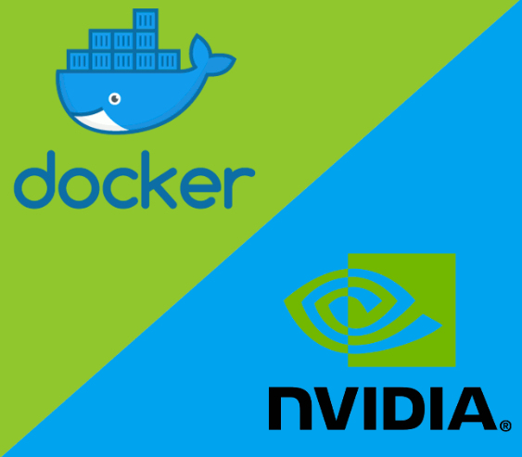
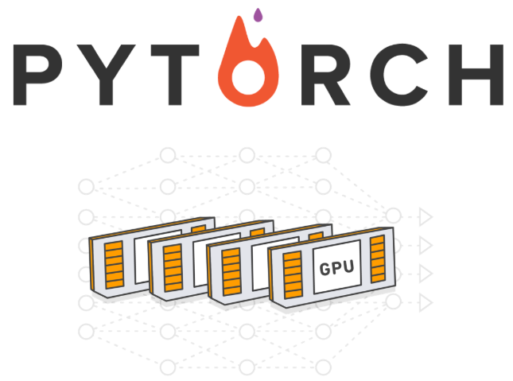
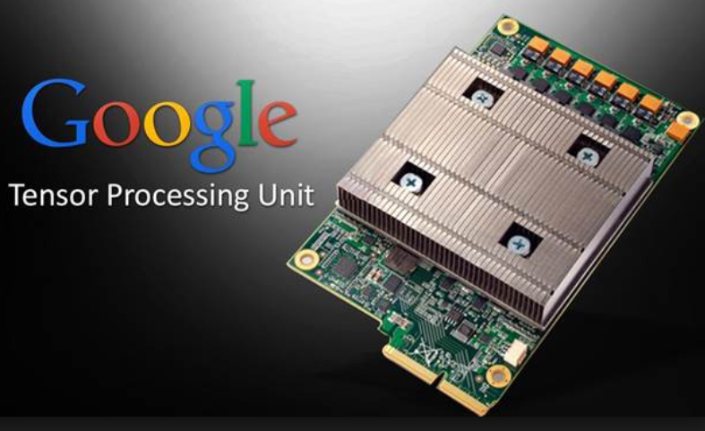
What is NOT here?
Notes:
What is ML?

Slide 4
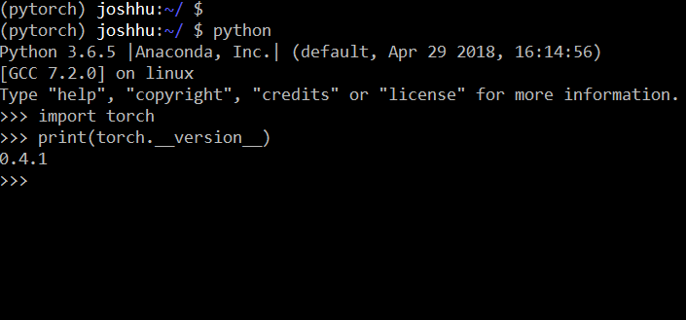
Goals
https://github.com/joshhu
Prepare Linux environment
CUDA
Prepare python environment
Prepare PyTorch environment
Prepare Jupyter
Notes:
What are the goals of these lectures?
We provide the basic …
In addition, we implement these concepts using pytorch to get concrete understanding.
To take and enjoy this course, you just need
basic … basic python. Zero to All!
I guess you are standing somewhere in the between here. Hopefully this lecture can help you move towards to the exper.
Let’s get started!

Slide 5
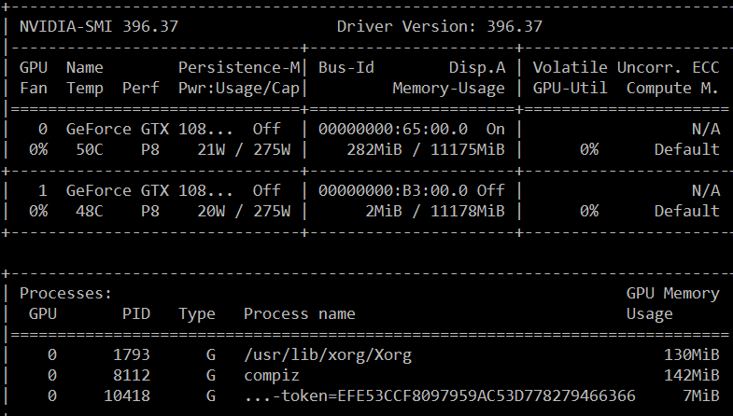
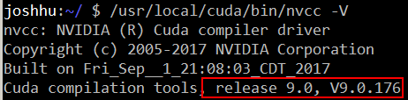
CUDA Environment
nvidia-smi
/usr/local/cuda/bin/nvcc -V
Notes:
How about human intelegene?

Slide 6
Linux Environment
sudo apt-get update
sudo apt-get upgrade
sudo apt-get install git
Notes:
How about human intelegene?

Slide 7

Python Environment
About 2, 3, packages and frameworks
Virtual envs management
Version management
FW/Package management
Pre-installed popular packages
Best Web-based IDE
Anaconda is your best friend!
Notes:
How about human intelegene?

Slide 8
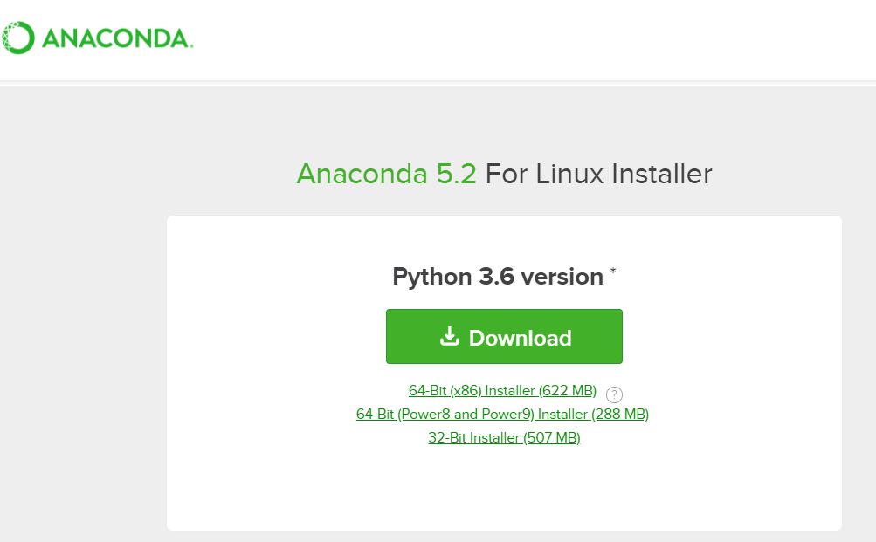
Anaconda Install
Download at https://www.anaconda.com/
Linux Version
Python3 64bit
Notes:
How about human intelegene?

Slide 9
Anaconda Install
Run anaconda install file
Create virtual environment named ‘py27’ for hand-made stuff.
Create virtual environment named ‘pytorch’
Install necessary packates
Switch to ‘pytorch’ environment
Notes:
How about human intelegene?

Slide 10
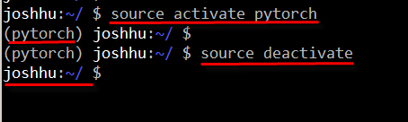
Anaconda Install
conda create -n pytorch anaconda nb_conda
pip install torch torchvision --upgrade
mkdir workspace
cd workspace
source activate pytorch
Notes:
How about human intelegene?

Slide 11
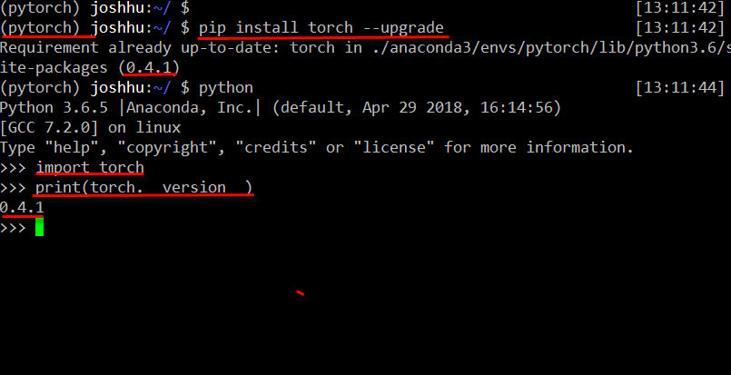
PyTorch Install
pip install torch --upgrade
Notes:
How about human intelegene?

